Slide 1
CalNex Data Workshop
11-Jan-2011
Characterizing near-shore and off-shore air masses in southern CA during CalNex
Brian Lerner^{1, 2}, Jim Johnson^{3, 4}, Eric Williams^{1, 2}
¹NOAA ESRL CSD, Boulder CO
²CIRES, University of Colorado at Boulder
³NOAA PMEL, Seattle WA
⁴JISAO, University of Washington

Slide 2
Outline
Review of measurements; status of data
“Cleaning” the data of influence from Atlantis
Gridding the data by location
Characterizing near-shore / off-shore air
CO, NO_{y} and O₃
Wind direction
Photochemical age
Clean marine vs. Los Angeles bight
CalNex data workshop: Outline / Data overview / Working with the data / So. CA: CO, NO_{x} and O₃ / Marine air / Characterizing LA bight air

Slide 3
Overview of measurements
“Final” data has been posted on the data server:
http://www.esrl.noaa.gov/csd/tropchem/2010calnex/
1-min resolution files
Gas-phase species: NO, NO₂, NO_{y}, O₃, CO, CO₂, SO_{2,} H₂O
Directly measured photolysis rates: NO₂, NO₃, O₃→O[1D]
Derived photolysis rates: ClNO₂, Cl₂, HONO, HCHO, etc.
Met. data: T, RH, pressure, wind speed and direction
1-s resolution data available by request
CalNex data workshop: Outline / Data overview / Working with the data / So. CA: CO, NO_{x} and O₃ / Marine air / Characterizing LA bight air

Slide 4
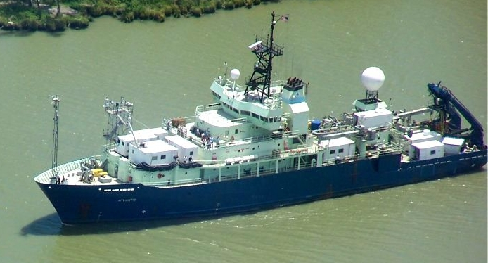
Sampling
Main inlet and anemometer located at starboard, forward corner of walk-up tower.
Due to location of tower relative to Atlantis exhaust stack, data filtered by relative wind direction from stern [135° wedge] and relative wind speed [< 0.02 m/s].
This removes ≈ 4.4% of sampling time from the dataset.
CalNex data workshop: Outline / Data overview / Working with the data / So. CA: CO, NO_{x} and O₃ / Marine air / Characterizing LA bight air

Slide 5
Working with the data
Traditionally, we work with data using time series
How about another approach?
CalNex data workshop: Outline / Data overview / Working with the data / So. CA: CO, NO_{x} and O₃ / Marine air / Characterizing LA bight air

Slide 6
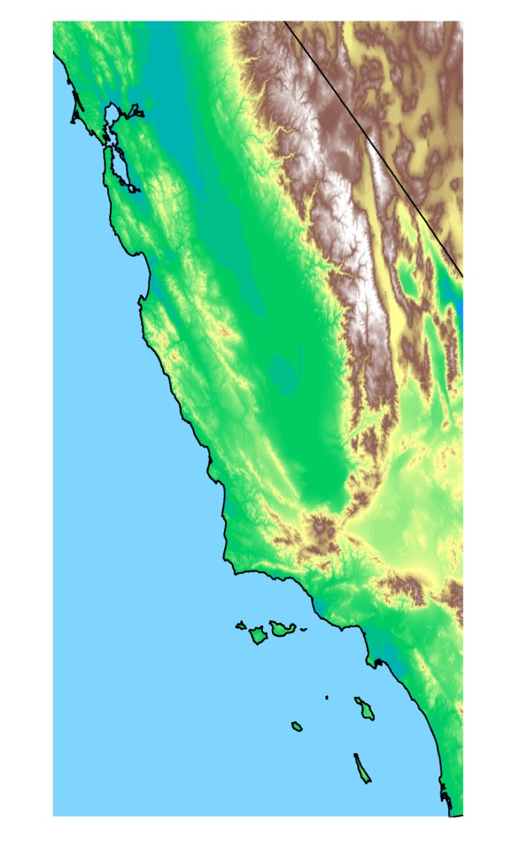
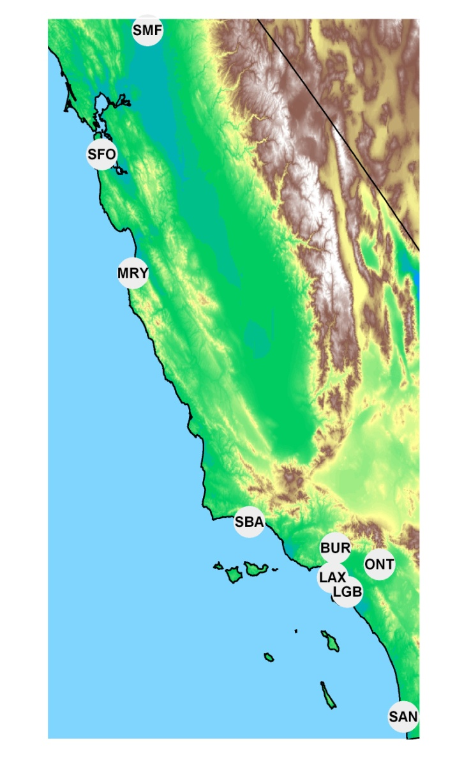
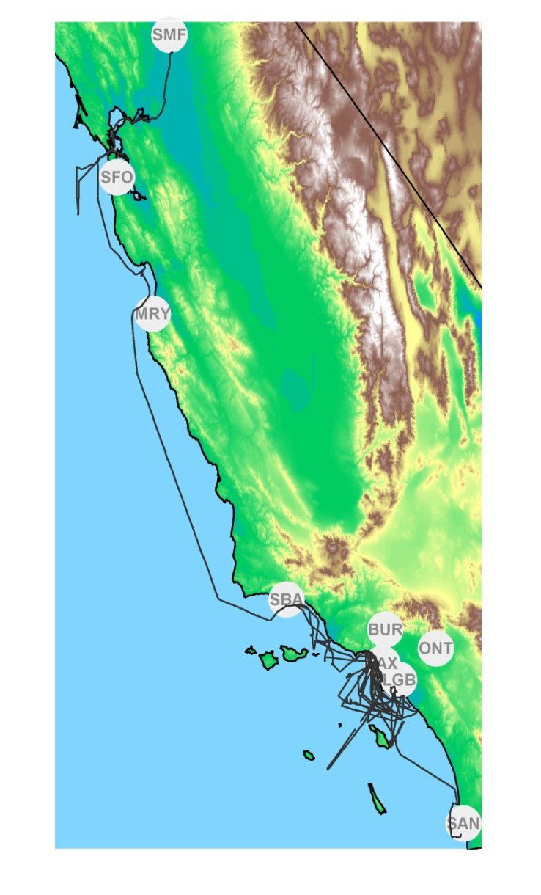
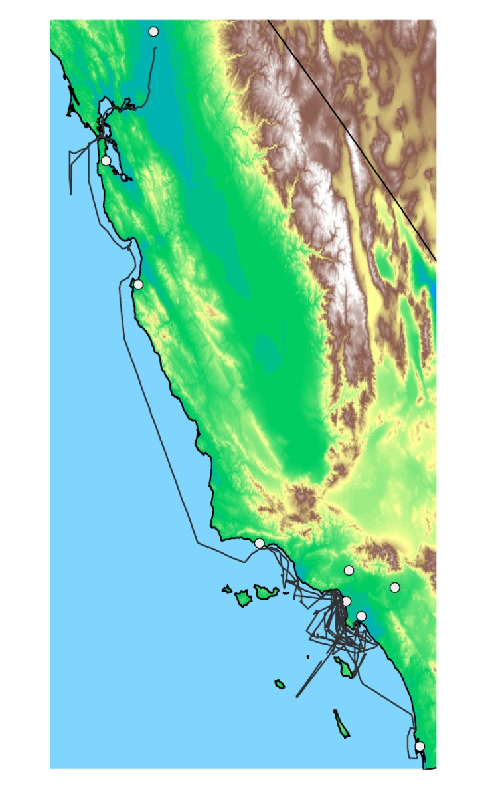
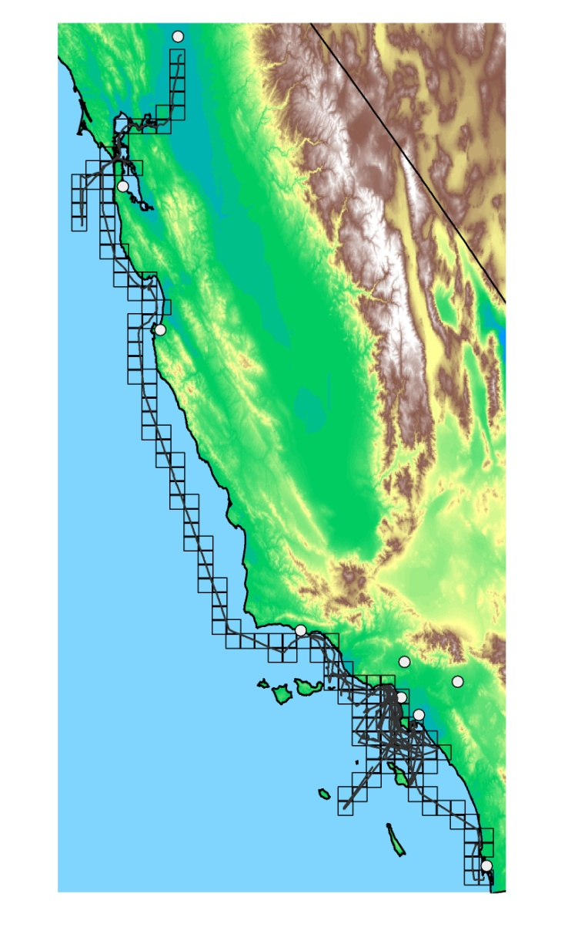
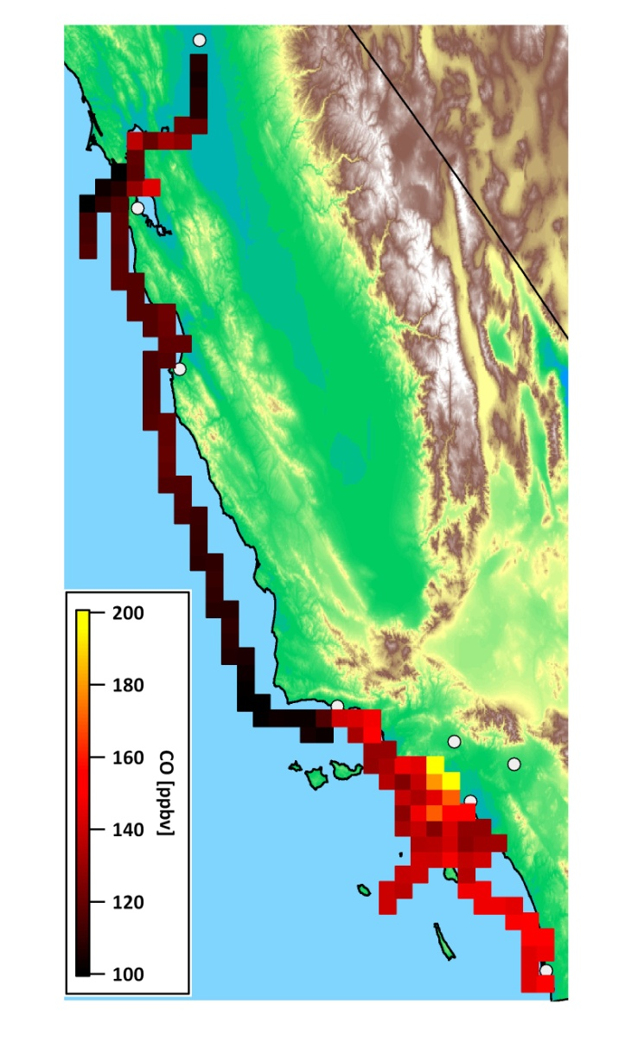
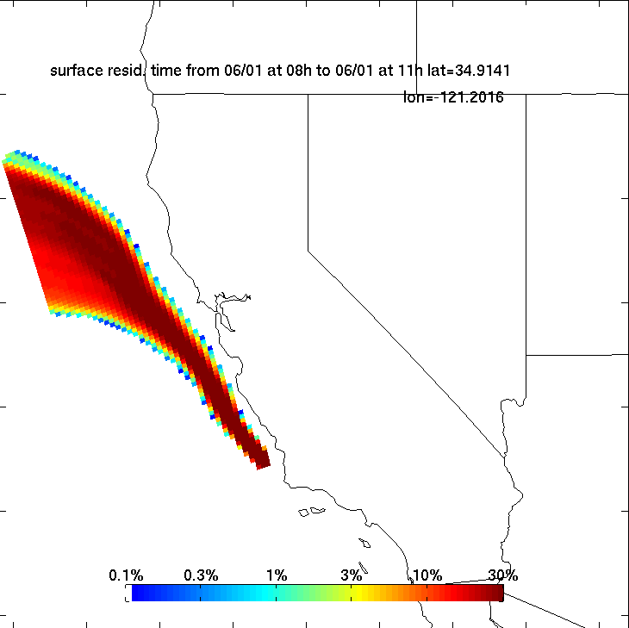
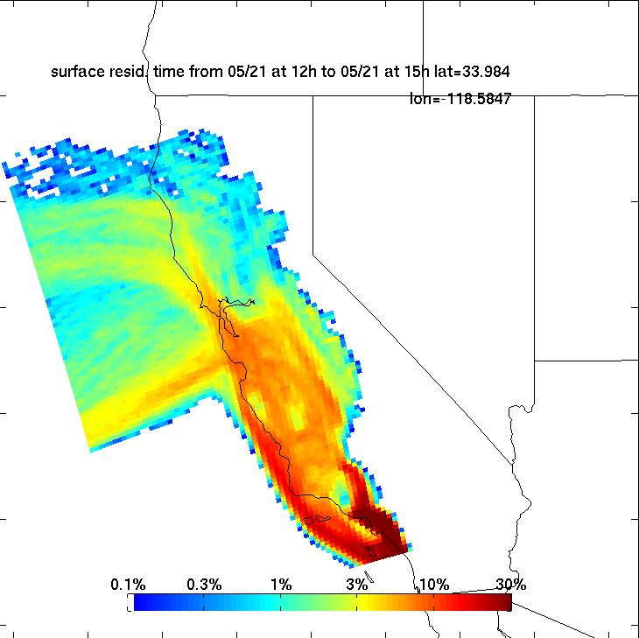
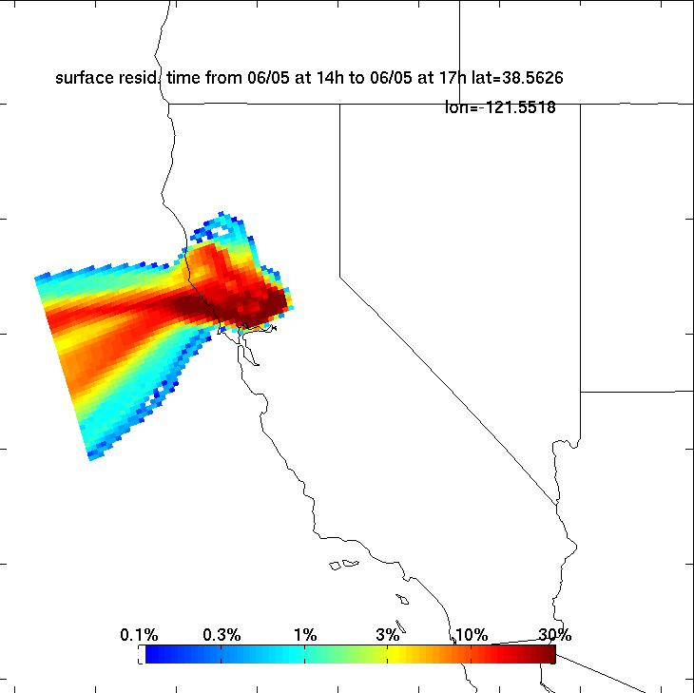
Working with the data
Putting the data on a map
CalNex data workshop: Outline / Data overview / Working with the data / So. CA: CO, NO_{x} and O₃ / Marine air / Characterizing LA bight air
Notes:
Introduce the grid on CA overview map
Show grid as a fxn of:
Time in grid
Time of day (6 steps)
Wind direction (6 steps)
Chemical species: CO and NOx
Using the grid
Aggregating the data when appropriate
Identifying key sample locations
Ports
Airport
Coastal LA
Santa Cruz
Carquinez Strait/Sacramento

Slide 7
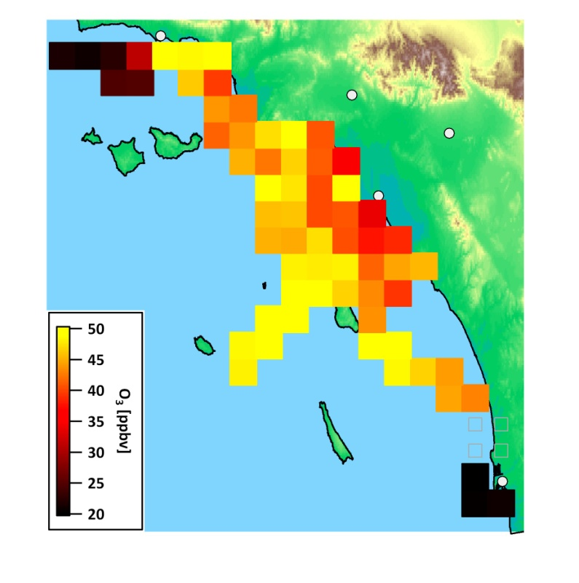
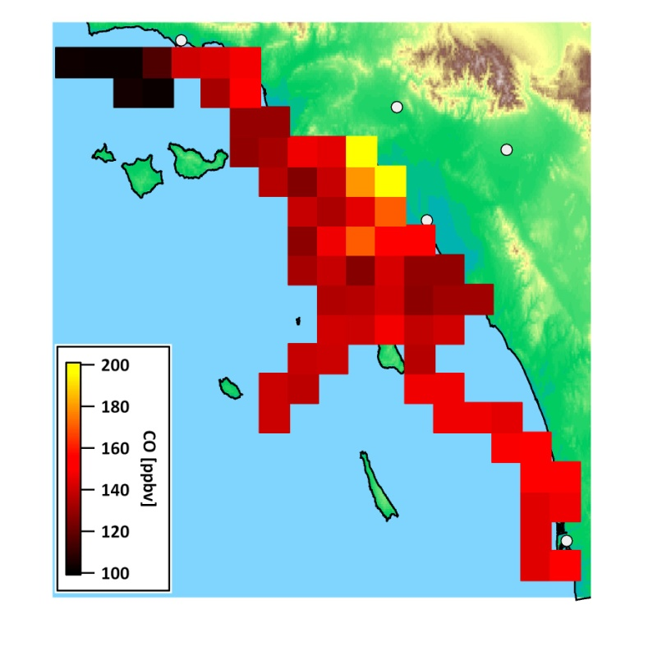
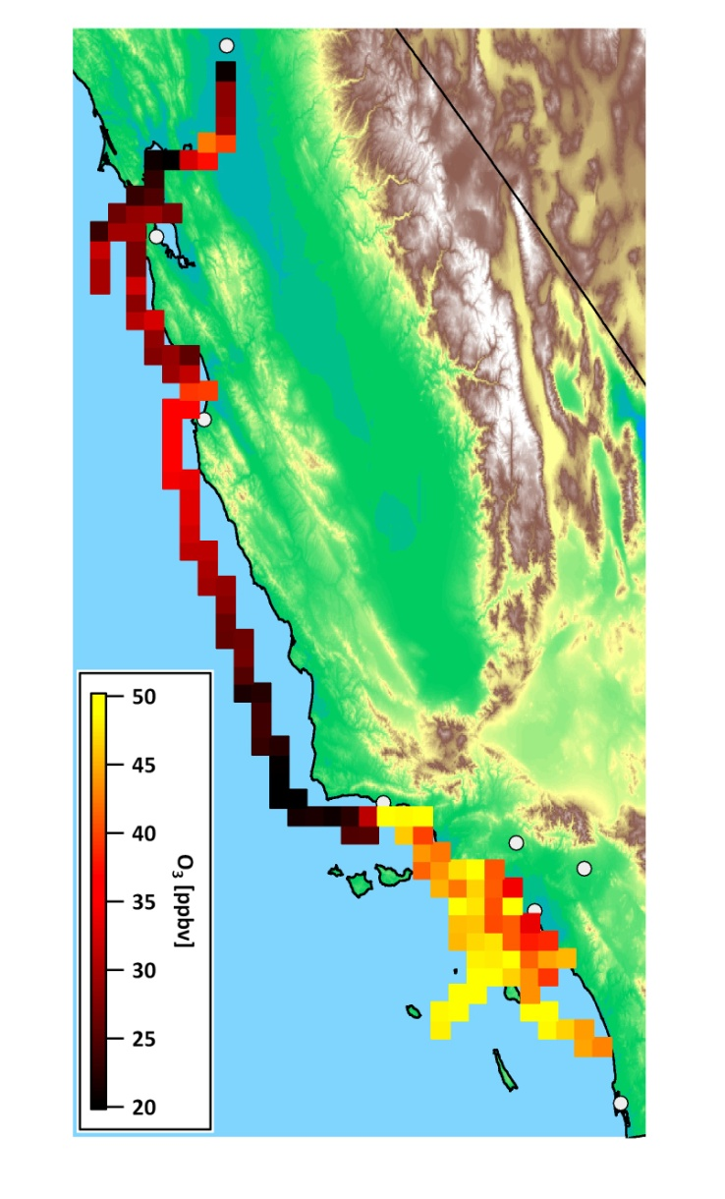
Emissions and photochemistry by location
Comparison of CO and O₃ footprint
CO gradient decreases as ship moves away from the coast
Ozone gradient increases as ship moves away from the coast
CalNex data workshop: Outline / Data overview / Working with the data / So. CA: CO, NO_{x} and O₃ / Marine air / Characterizing LA bight air

Slide 8
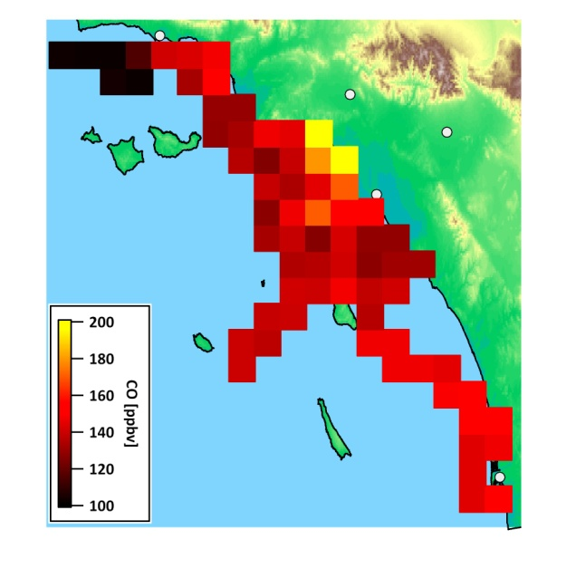
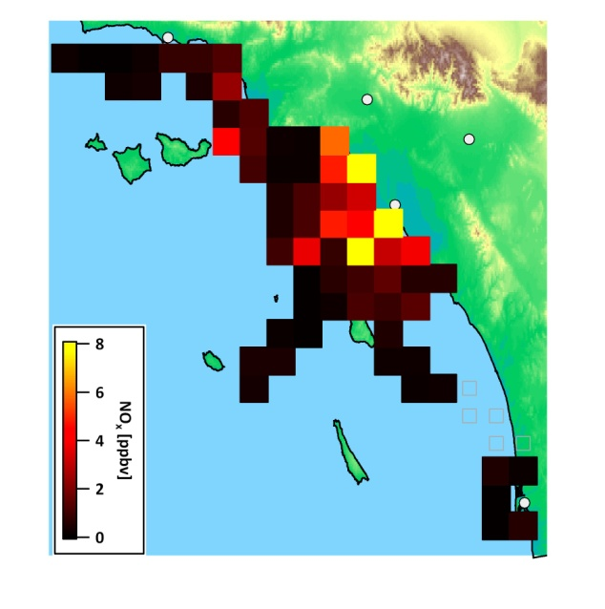
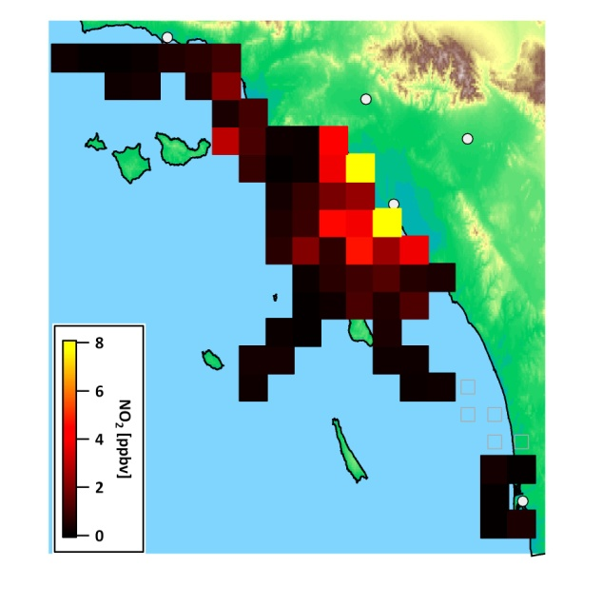
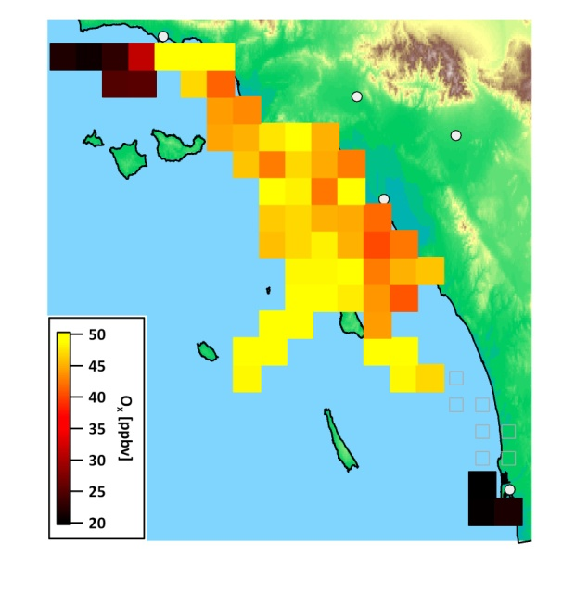
Emissions and photochemistry by location
Observable gradient from coast out to sea:
What about NO_{x}?
NO primarily emitted, but significant NO₂ measured.
Rapid titration reaction with ozone
NO + O₃ → NO₂ + O₂
Better to consider O_{x} [= NO₂ + O₃]
CalNex data workshop: Outline / Data overview / Working with the data / So. CA: CO, NO_{x} and O₃ / Marine air / Characterizing LA bight air

Slide 9
Emissions and photochemistry by location
How do the species mixing ratios change as a function of wind direction?
CalNex data workshop: Outline / Data overview / Working with the data / So. CA: CO, NO_{x} and O₃ / Marine air / Characterizing LA bight air
Notes:
Watching the mix change as a function of wind direction
Why do highest Ox mixing ratios coincide with S and SW flow?
How does time of day correlate with wind direction?
Dividing the grid into regions: Inshore/offshore LA basin (LA and Orange Counties)
Two grid cells removed from grouping: LAX and ports (special cases)

Slide 10
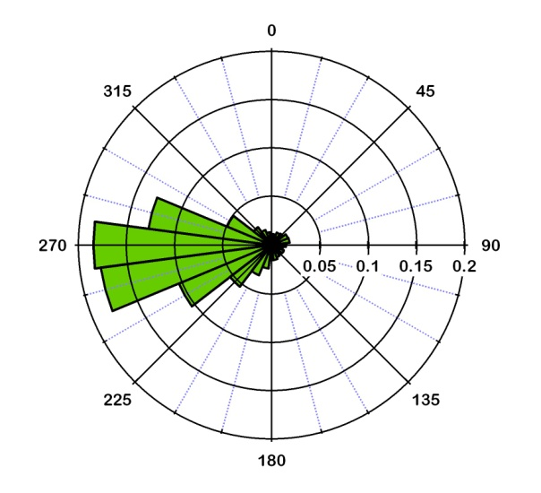
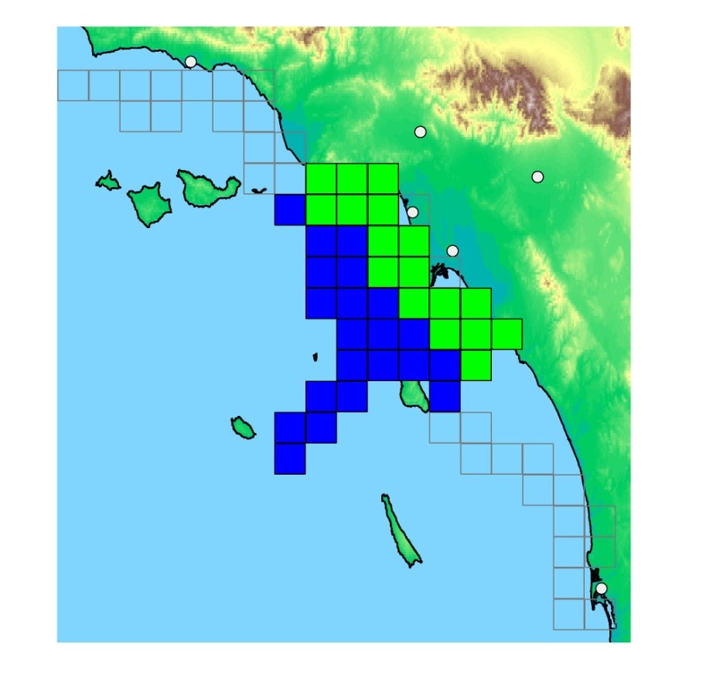
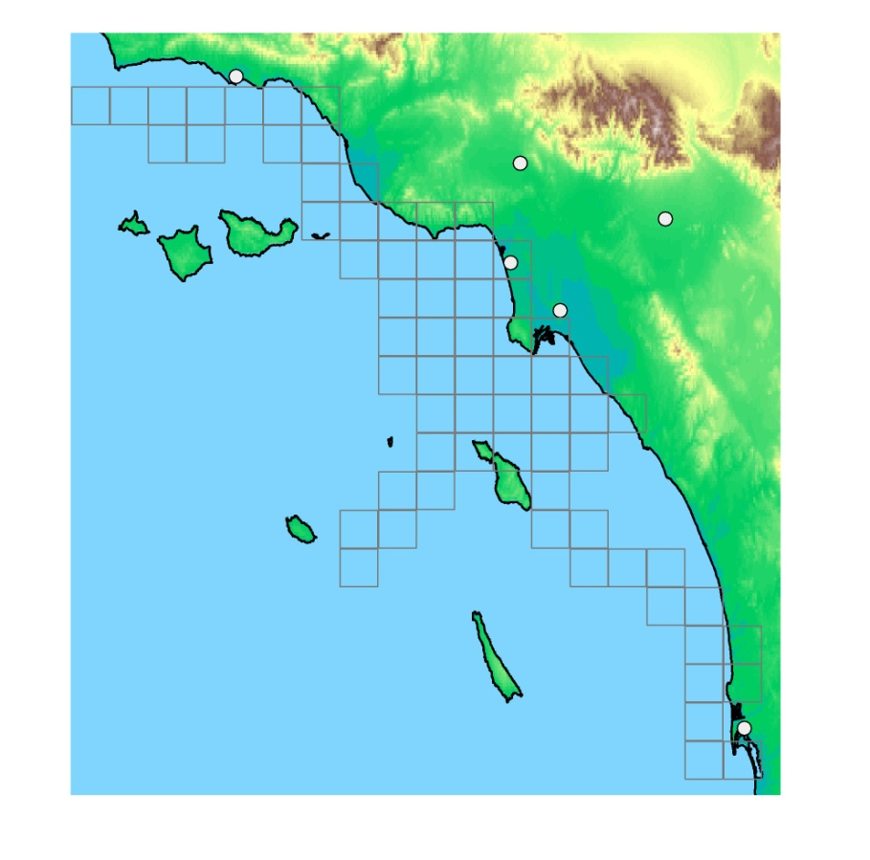
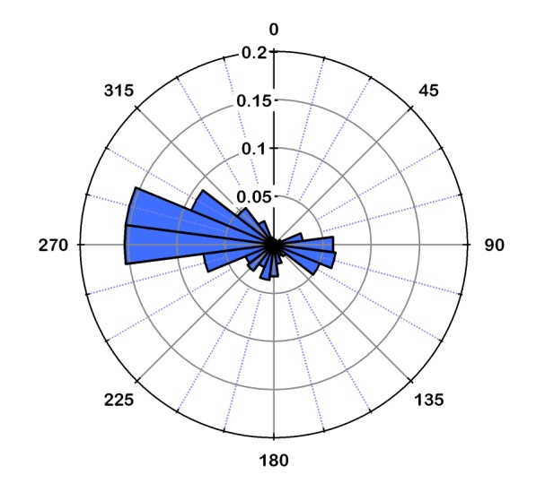
Aggregating the data by location
Near
CO
NO_{x} & NO_{y}
O₃ & O_{x}
Off
CO
NO_{x} & NO_{y}
O₃ & O_{x}
Dividing the grid into regions: near-shore/off-shore LA basin (LA and Orange Counties)
Two grid cells removed from grouping: LAX and ports (special cases)
CalNex data workshop: Outline / Data overview / Working with the data / So. CA: CO, NO_{x} and O₃ / Marine air / Characterizing LA bight air

Slide 11
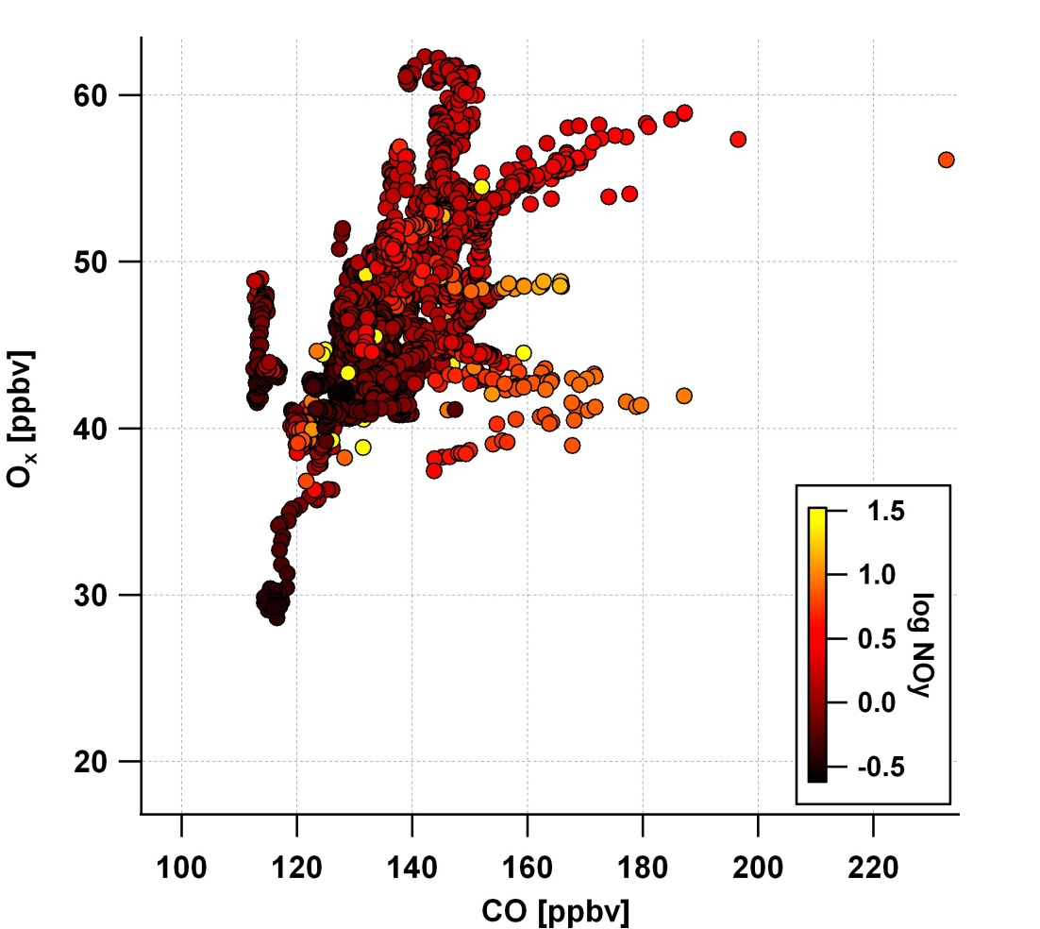
A further look at off-shore air
O_{x} vs. CO
How can we make sense of this scatterplot?
With a digression . . .
CalNex data workshop: Outline / Data overview / Working with the data / So. CA: CO, NO_{x} and O₃ / Marine air / Characterizing LA bight air

Slide 12
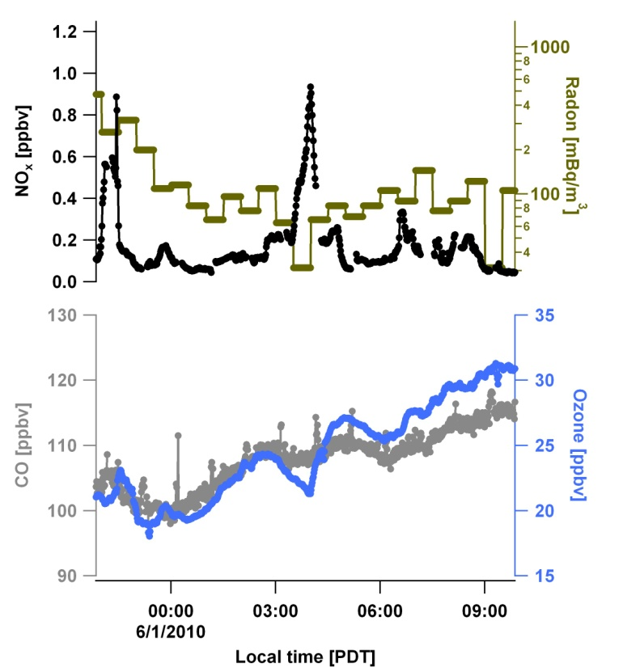
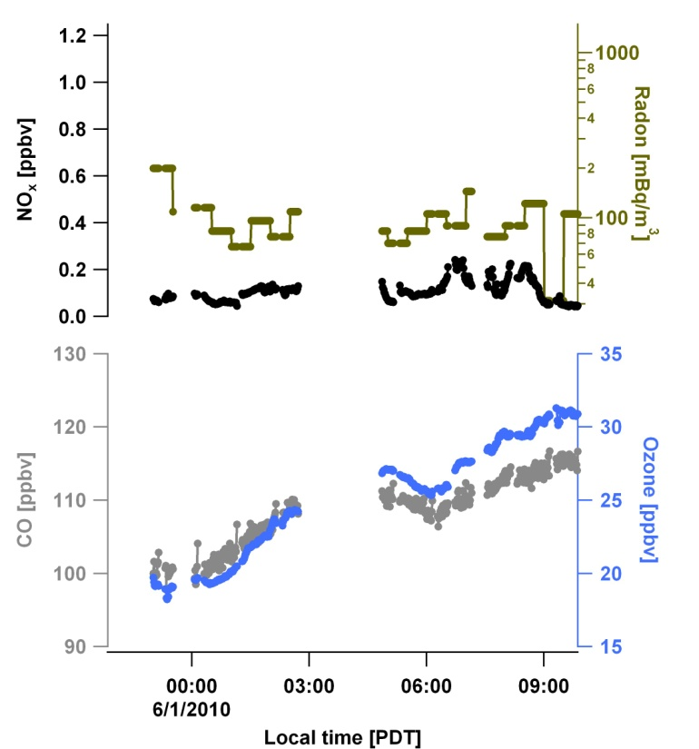
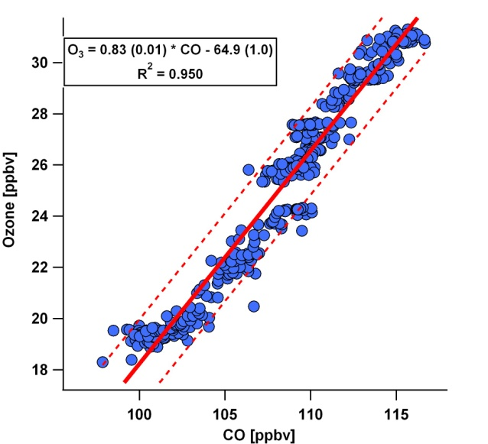
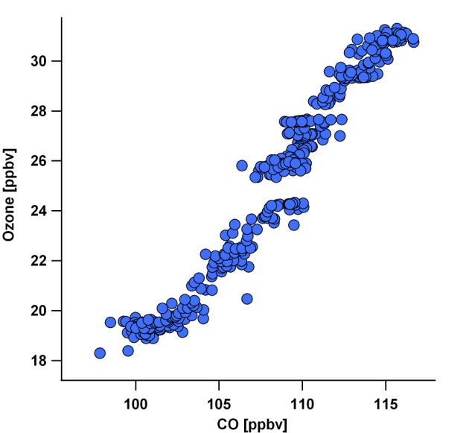
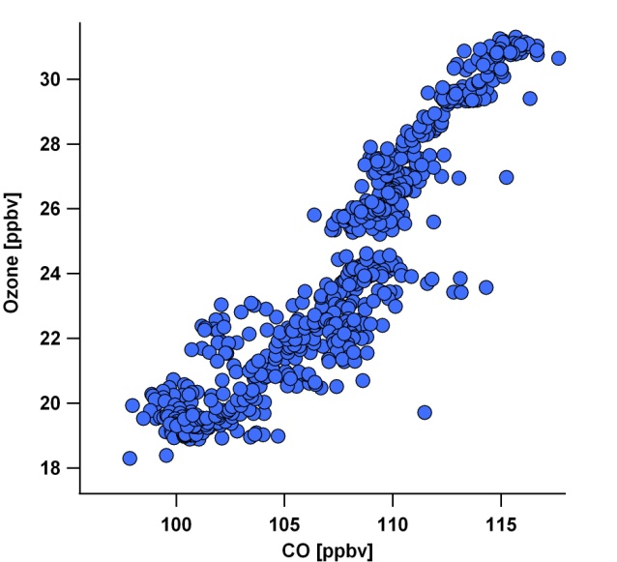
Characterizing marine background
NO_{x} < 0.25 ppbv
Radon < 200
Trend likely from mixing of clean tropical and very old polluted air
CalNex data workshop: Outline / Data overview / Working with the data / So. CA: CO, NO_{x} and O₃ / Marine air / Characterizing LA bight air

Slide 13
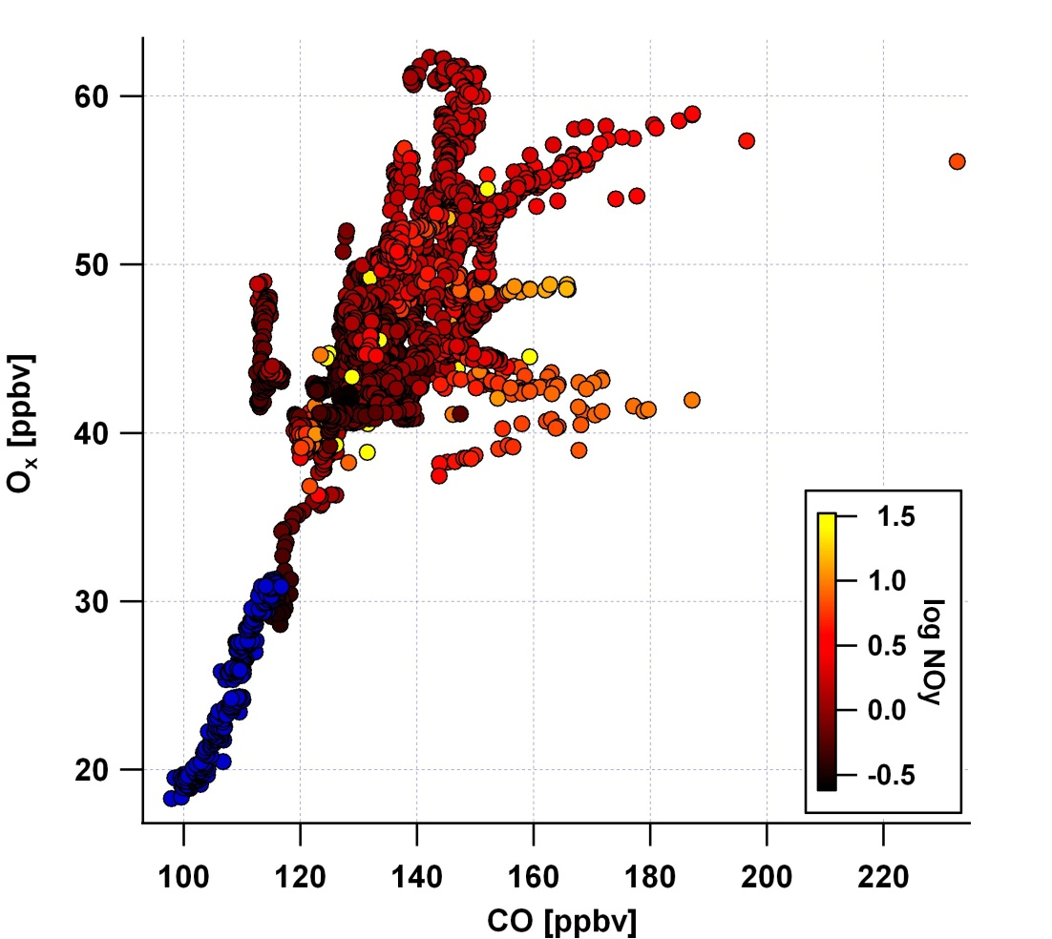
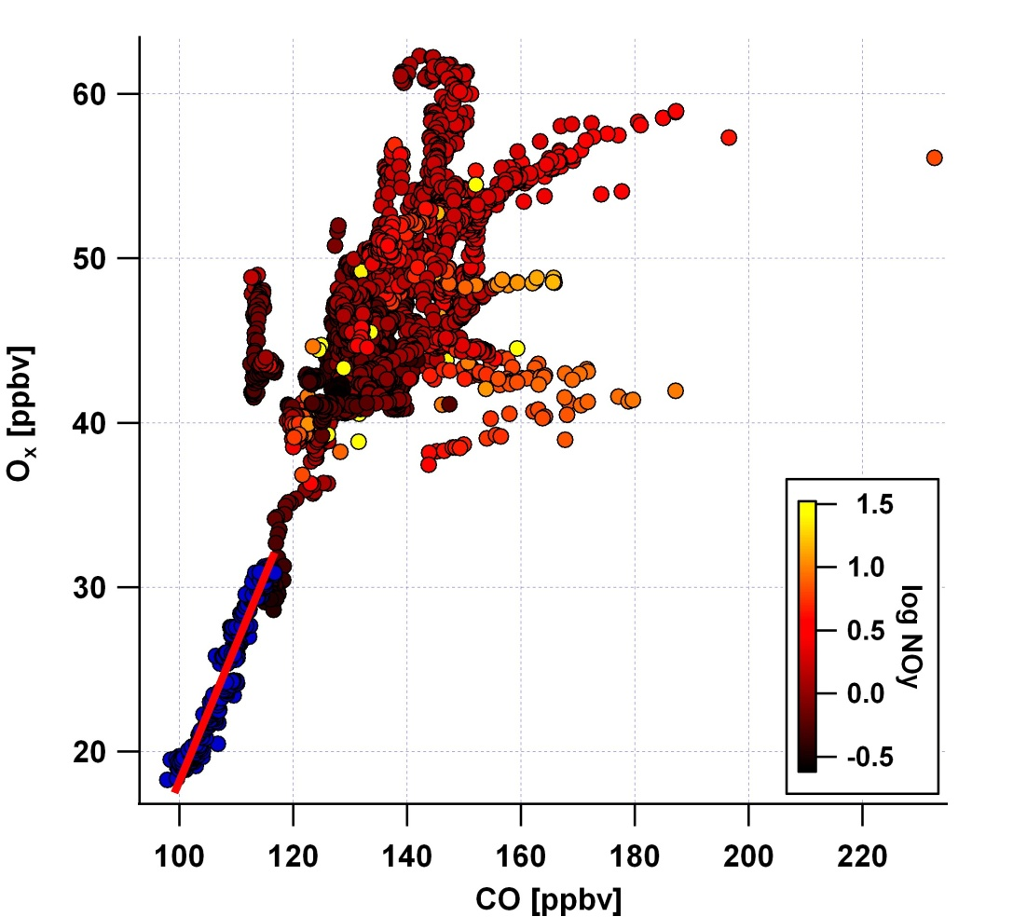
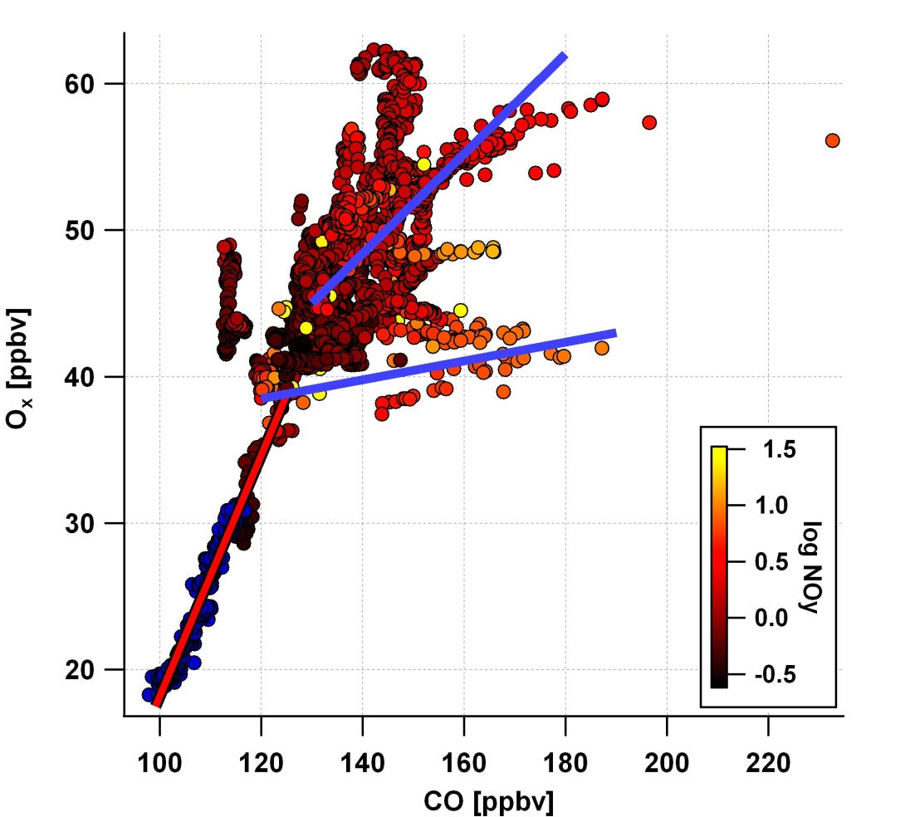
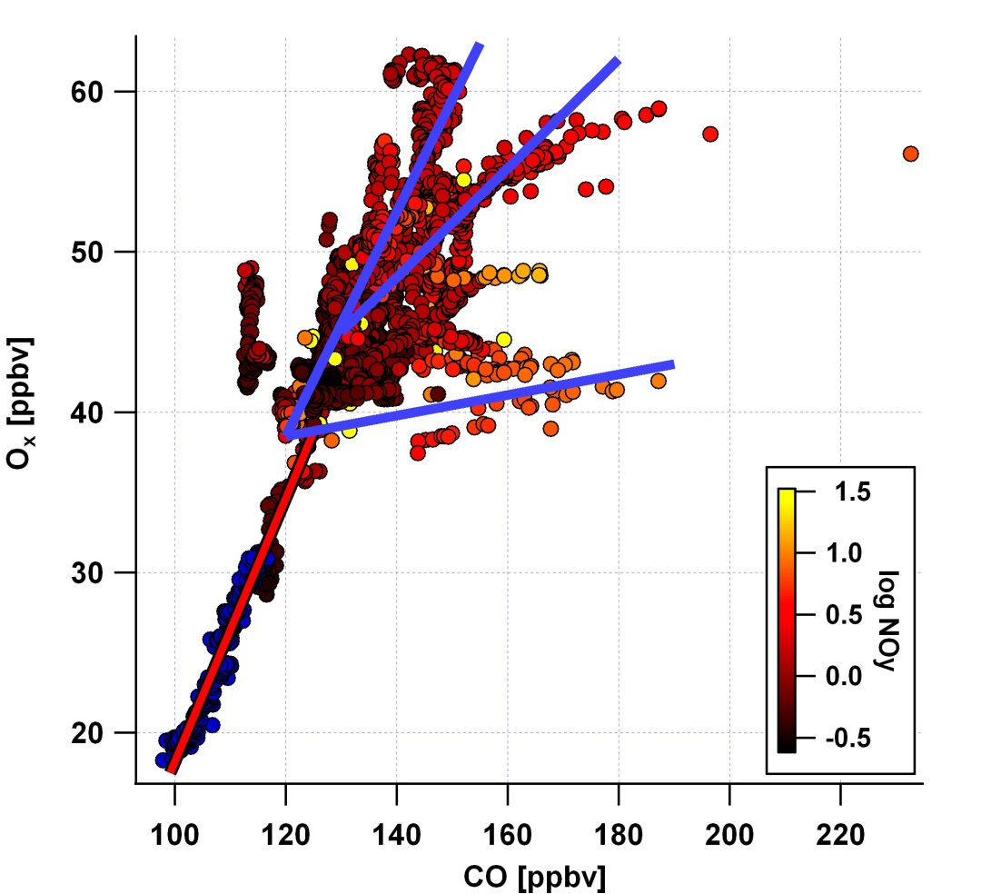
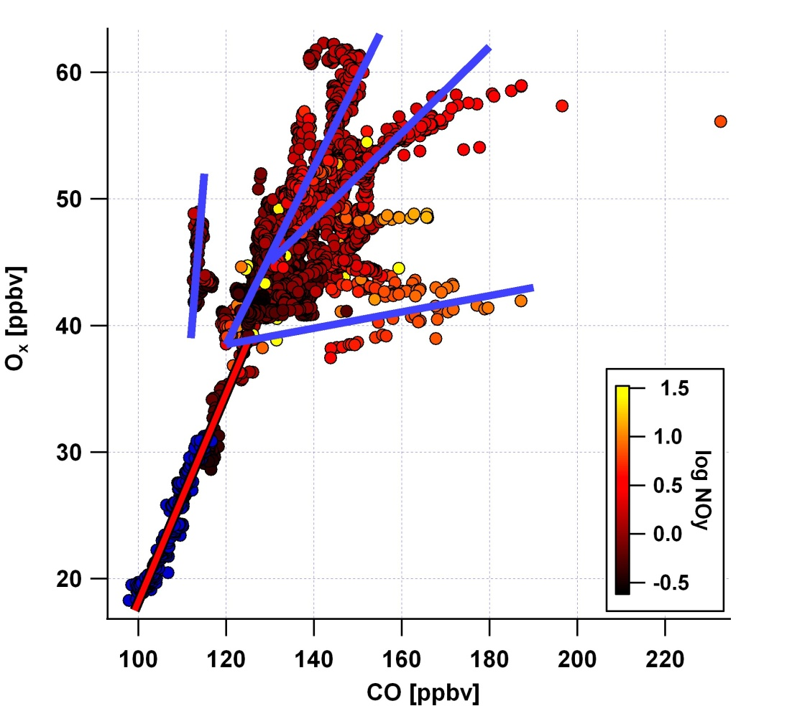
A further look at off-shore air
How does the SB-Monterrey air compare with So. CA off-shore air?
Finding a correlation in the off-shore data:
What is reasonable?
Increasing slope = more processing
CalNex data workshop: Outline / Data overview / Working with the data / So. CA: CO, NO_{x} and O₃ / Marine air / Characterizing LA bight air

Slide 14
What’s next to do?
Summary
Evaluating dataset by location important to making sense of observations
Near-shore air shows marked differences in photochemical processing as a function of wind direction
Off-shore air generally well-mixed, independent of wind direction
OVOCs? Organic acids? SOA?
How well does Flexpart predict CO, NOy, etc. at ship location?
Can we characterize the source and age of the ozone-enriched air off-shore?
How does air transported across LA basin to Pasadena compare to air that ages over the water?
CalNex data workshop: Outline / Data overview / Working with the data / So. CA: CO, NO_{x} and O₃ / Marine air / Characterizing LA bight air

